Slide 1
Banco di Portugal 2014 Telemarketing Campaign
Visualization and Analysis of Data

Slide 2
Introduction
This dataset records various attributes of a selection of Banco di Portugal’s clients and the outcomes of a telemarketing campaign run in 2014 to persuade them to open term deposit accounts
It is publicly available for research (please check the description at: http://archive.ics.uci.edu/ml/datasets/Bank+Marketing)
Originally described and analysed by Sérgio Moro (ISCTE-IUL), Paulo Cortez (Univ. Minho) and Paulo Rita (ISCTE-IUL)
Citation: [Moro et al., 2014] S. Moro, P. Cortez and P. Rita. A Data-Driven Approach to Predict the Success of Bank Telemarketing. Decision Support Systems, In press, http://dx.doi.org/10.1016/j.dss.2014.03.001. Available at:
[pdf] http://dx.doi.org/10.1016/j.dss.2014.03.001
[bib] http://www3.dsi.uminho.pt/pcortez/bib/2014-dss.txt
Dataset contains 41188 rows and 21 columns

Slide 3
Column Names + Descriptions
# bank client data:
1 - age (numeric)
2 - job : type of job (categorical: "admin.","blue-collar","entrepreneur","housemaid","management","retired","self- employed","services","student","technician","unemployed","unknown")
3 - marital : marital status (categorical: "divorced","married","single","unknown"; note: "divorced" means divorced or widowed)
4 - education: (categorical: "basic.4y","basic.6y","basic.9y","high.school","illiterate","professional.course","university.degree","unknown")
5 - default: has credit in default? (categorical: "no","yes","unknown")
6 - housing: has housing loan? (categorical: "no","yes","unknown")
7 - loan: has personal loan? (categorical: "no","yes","unknown")
# related with the last contact of the current campaign:
8 - contact: contact communication type (categorical: "cellular","telephone")
9 - month: last contact month of year (categorical: "jan", "feb", "mar", ..., "nov", "dec")
10 - day_of_week: last contact day of the week (categorical: "mon","tue","wed","thu","fri")
11 - duration: last contact duration, in seconds (numeric). Important note: this attribute highly affects the output target (e.g., if duration=0 then y="no"). Yet, the duration is not known before a call is performed. Also, after the end of the call y is obviously known. Thus, this input should only be included for benchmark purposes and should be discarded if the intention is to have a realistic predictive model.
# other attributes:
12 - campaign: number of contacts performed during this campaign and for this client (numeric, includes last contact)
13 - pdays: number of days that passed by after the client was last contacted from a previous campaign (numeric; 999 means client was not previously contacted)
14 - previous: number of contacts performed before this campaign and for this client (numeric)
15 - poutcome: outcome of the previous marketing campaign (categorical: "failure","nonexistent","success")
# social and economic context attributes
16 - emp.var.rate: employment variation rate - quarterly indicator (numeric)
17 - cons.price.idx: consumer price index - monthly indicator (numeric)
18 - cons.conf.idx: consumer confidence index - monthly indicator (numeric)
19 - euribor3m: euribor 3 month rate - daily indicator (numeric)
20 - nr.employed: number of employees - quarterly indicator (numeric)
# Output variable (desired target):
21 – y: has the client subscribed a term deposit? (binary: "yes","no")

Slide 4
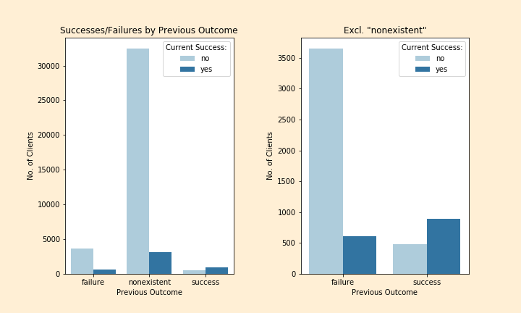
Total Success/Failure Counts by Outcome of Previous Campaign (‘nonexistent’ = no previous contact)
Total number of clients contacted: 41,188
Total successful: 4640
Total success rate: 11.3%

Slide 5
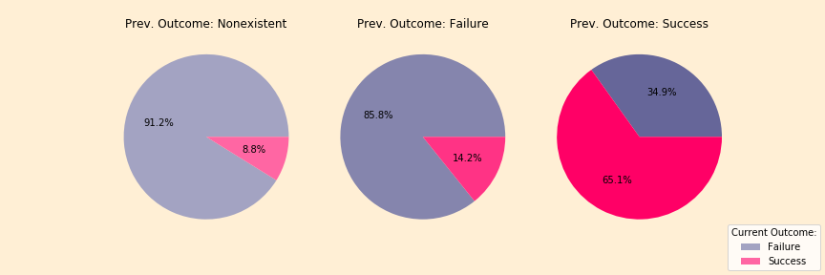
Current Campaign Success Rates (%) Grouped by Outcomes of Previous Campaign
Total number of clients contacted: 41,188
Total successful: 4640
Total success rate: 11.3%
It is clear from the diagram on the far right that a previous success significantly improved the chances of a further success with the same client
The leftmost diagrams show that the chance of a success was around 50% higher if the client had received a call during the previous campaign – it might therefore be beneficial to make repeat calls to clients over certain time periods if they do not sign up immediately

Slide 6
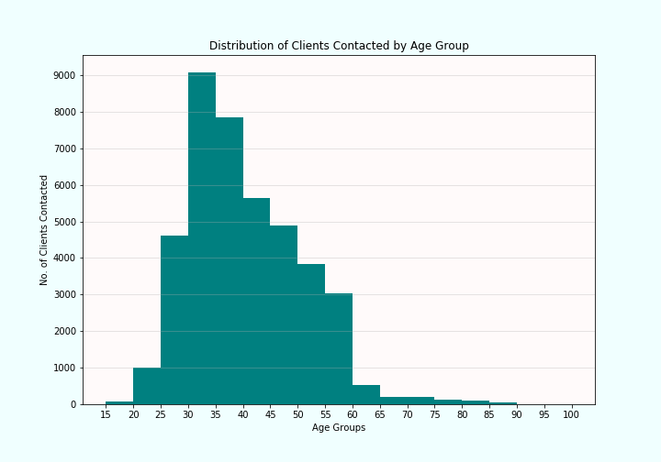
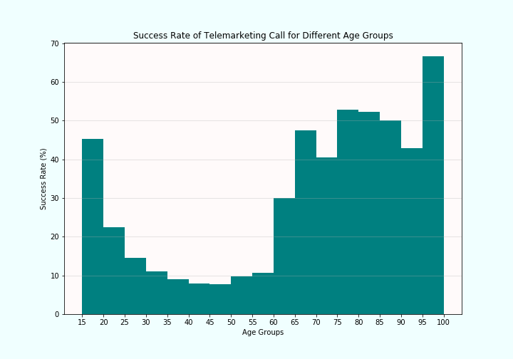
Number of Clients Contacted vs Success Rates by Age Group
The majority of clients contacted fit within a 25-60 age bracket, however the success rate of calls was strongest for the 60-and-above age groups
Accordingly, if the bank’s primary objective is to increase the number of term deposit accounts opened, it might consider targeting older age groups more

Slide 7
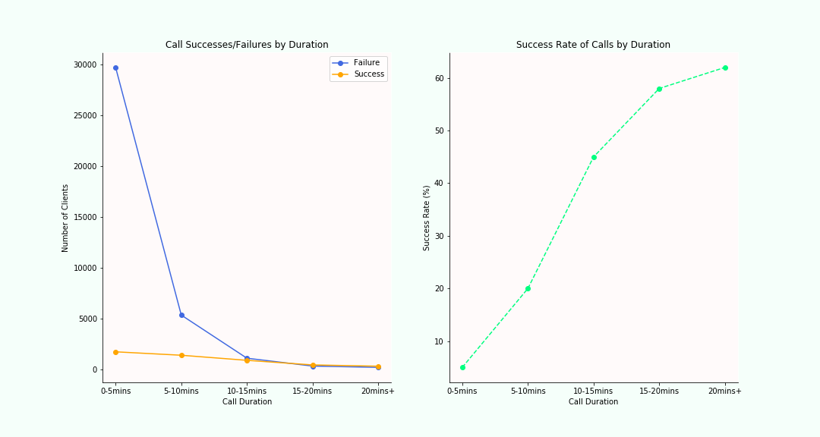
Number of Successes/Failures vs Success Rates Categorised by Call Duration
There is a clear positive correlation between call duration and success rates
However, correlation is not causation (e.g. the high failure rate of 0-5 minute calls is likely to be a reflection of an inherent lack of interest being discovered early on)
Similarly, although some clients may have required more time to be persuaded, some calls may have been longer due to other factors (e.g. general chit-chat, taking longer to go through details or process the opening of an account)
Optimum timing target in future campaigns likely to be 10-20 minutes, since the marginal increase in success tapers off after this point

Slide 8
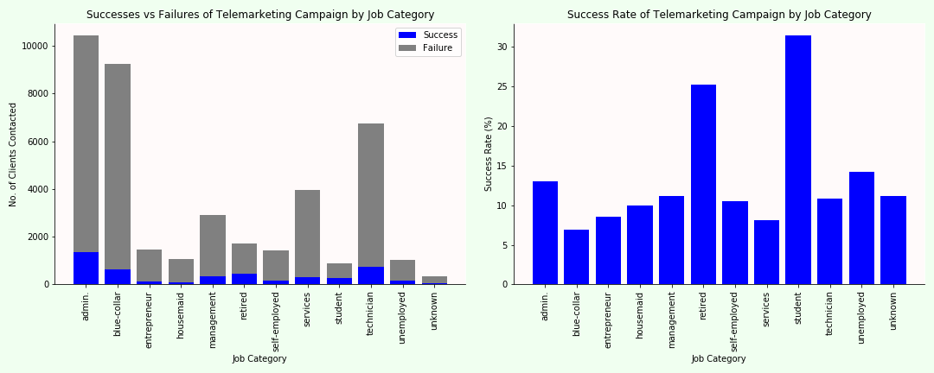
Success/Failure Counts & Success Rates by Job Category
Greatest success rates appear to be those of retired clients and students, which are both 10% higher than those of other groups or more

Slide 9
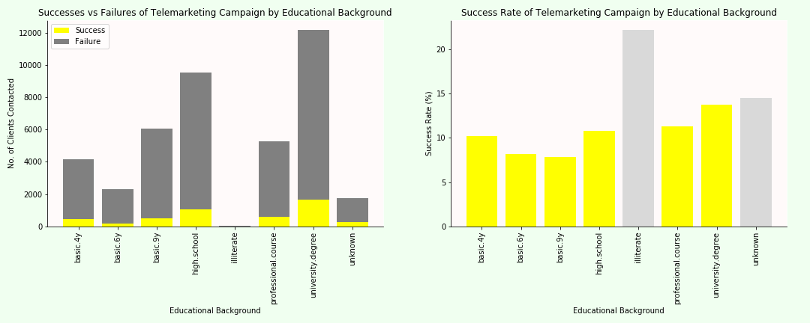
Success/Failure Counts & Success Rates by Educational Background
* Non-useful categories greyed-out
Percentage success rate between different educational backgrounds was relatively marginal
However, those with higher levels of education were slightly more likely to open accounts, possibly because their incomes are likely to have been higher

Slide 10
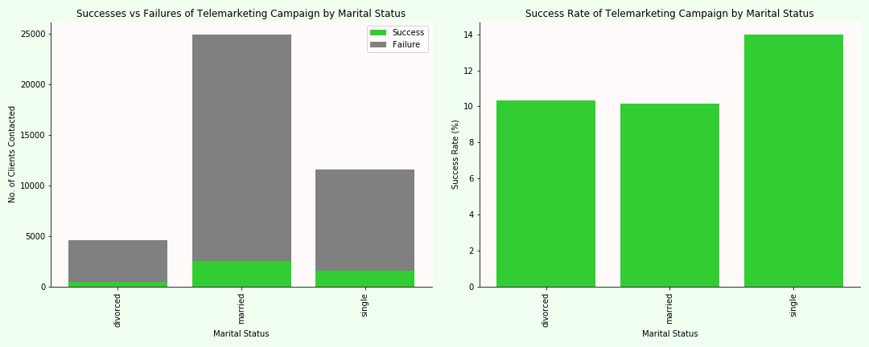
Success/Failure Counts & Success Rates by Marital Status
Single clients were 40% more likely to open an account than those who were married or divorced

